Slide 1



KaggleX- Project
Notes:
Recommending picking out he most interesting and important parts from your documentation.

Slide 2
Advancing Maternal and Neonatal Care: A Cardiotocography-Based Prognostic Model for Fetal Health Classification
Victor M. Adeleye

Slide 3
Background
Medical Doctor and Data Enthusiast: I am a Medical Doctor with a strong passion for data science and its applications in healthcare.
Data-Driven Problem Solver: I possess strong technical skills in data analytics and machine learning, and I aspire to bridge the worlds of medicine and data to revolutionize healthcare solutions.
Public Health Advocate: Involved in public health research and primary healthadvocacy.

Slide 4
Introduction
Child and maternal mortality rates remain critical indicators of a nation's healthcare progress. Addressing these challenges is a cornerstone of the United Nations' Sustainable Development Goals.
A significant portion of maternal deaths, around 94%, occurs in low-resource settings and tragically, most of these losses could have been prevented.
Cardiotocography (CTG) is a non-invasive method of monitoring fetal health during pregnancy. A CTG functions by emitting ultrasound pulses and recording their echoes, providing vital information on fetal heart rate, movements, uterine contractions, and more.

Slide 5
Project Definition
The dataset under examination comprises 2126 records, each with features meticulously extracted from CTG examinations. Expert obstetricians have meticulously classified these records into three critical categories: "Normal", "Suspect", and "Pathological".
The overarching goal of this endeavor is to develop a robust model capable of accurately classifying fetal health based on the rich CTG data. Through this, we aim to contribute significantly towards reducing preventable child and maternal mortality, aligning with the UN's vision to limit under-5 mortality to 25 per 1,000 live births by 2030.

Slide 6
Project Definition
Maternal and Fetal Health Knowledge:
Feature Engineering:
Classification Techniques: Gain experience in applying various classification algorithms such as Random Forest, Gradient Boosting, and others for accurate fetal health classification.
Model Evaluation and Selection: Learn how to evaluate classification models using appropriate metrics like accuracy, precision, recall, F1-score, and choose the most suitable model for the task.
Handling Class Imbalance:
Dimensionality Reduction:

Slide 7
Data Loading and Preprocessing
Load and explore the dataset.
Handle any missing or erroneous values.
Perform feature scaling or normalization if needed.
Encode categorical variables

Slide 8
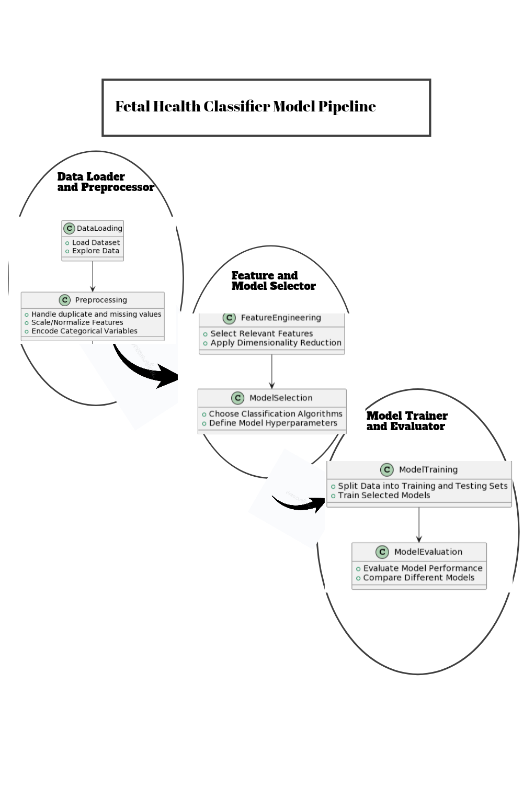
Model Pipeline flow

Slide 9
Model Development:
Choice of Algorithms (e.g., Random Forest, Gradient Boosting)
Data Preprocessing (e.g., Feature Engineering, Handling Missing and duplicate Values)
Model Training and Validation
Feature Importance Analysis

Slide 10
Purpose
Routine Prenatal Care: Integration into routine prenatal care for additional fetal health monitoring.
High-Risk Pregnancies: Support in assessing fetal well-being in pregnancies deemed high-risk.
Remote Monitoring: Application in telemedicine for remote fetal health assessment.
Decision Support: Provides insights and aids in making informed care decisions for both mother and fetus.
Triage in Emergencies: Assists in prioritizing care in emergency situations related to pregnancy.
Education and Training: Educational tool for healthcare professionals to enhance understanding of fetal health assessment.
Research and Clinical Studies: Utilized in research studies to analyze trends and outcomes in fetal health.
Resource Allocation: Aids in early identification of cases requiring additional resources or specialized care, optimizing resource allocation.

Slide 11
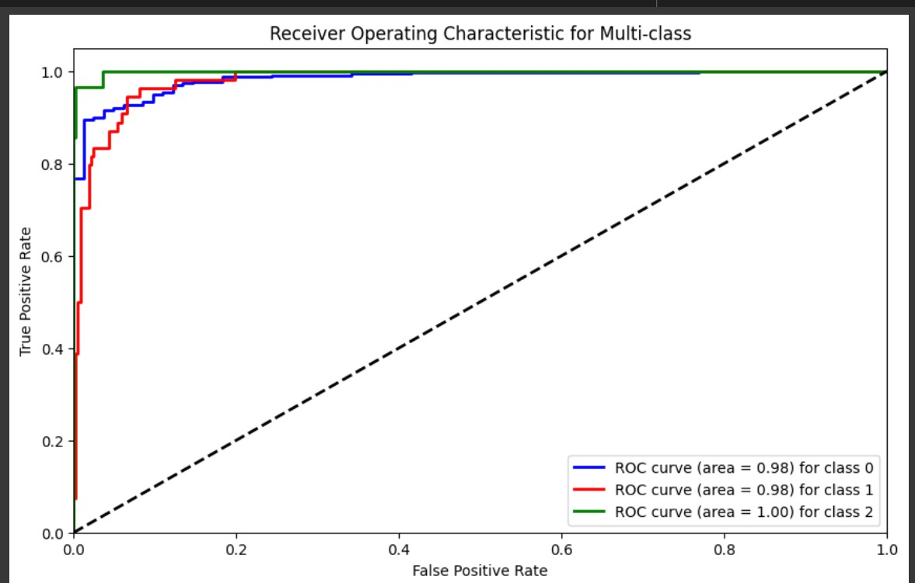
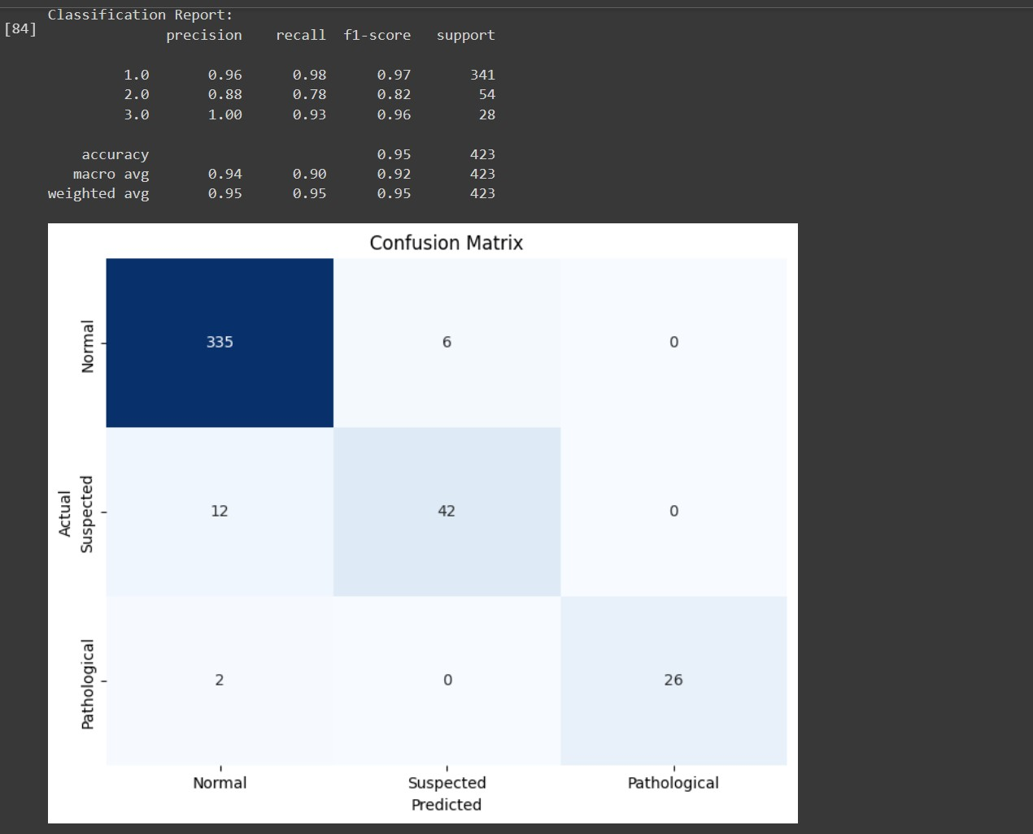
Model Evaluation

Slide 12
Recommendation
- Implement the developed fetal health classification model in routine prenatal care to augment healthcare professionals' ability to monitor fetal well-being.
- Integrate the model into telemedicine applications to facilitate remote monitoring of fetal health, particularly in situations where physical presence at a healthcare facility is challenging.
- Consider conducting further research and clinical studies utilizing the model's predictions to analyze trends and outcomes related to fetal health, thereby contributing to advancements in the field of obstetrics.

Slide 13
Conclusion
In conclusion, the project successfully developed a robust machine learning model for fetal health classification, offering valuable insights for maternal care. The model's potential applications include routine prenatal care, high-risk pregnancy assessments, and remote monitoring, contributing to improved healthcare outcomes. This project aligns with the global effort to reduce child and maternal mortality, emphasizing the significance of accurate fetal health assessment.

Slide 14
Project Links
Github link to the full files: https://github.com/victormayowa/fetal_health_classifier_kaggle_project

